Slide 1
Predicting 2000 Presidential Election Results At the County Level Using Census Data
Mose Wintner
mose.wintner@gmail.com
Kaiser Permanente Health Innovation Studio
April 6, 2018

Slide 2
Motivation
“One of the big lessons from behavioral economics is that we make decisions as a function of the environment that we're in.”
--Dan Ariely

Slide 3
Motivation
“One of the big lessons from behavioral economics is that we make decisions as a function of the environment that we're in.”
--Dan Ariely
Question: Can we use 2000 census data to predict county-level results of the 2000 presidential election?

Slide 4
Motivation
“One of the big lessons from behavioral economics is that we make decisions as a function of the environment that we're in.”
--Dan Ariely
Question: Can we use 2000 census data to predict county-level results of the 2000 presidential election?
Bonus question: Which variables collected by the census are most predictive of the way counties voted in the presidential election?

Slide 5
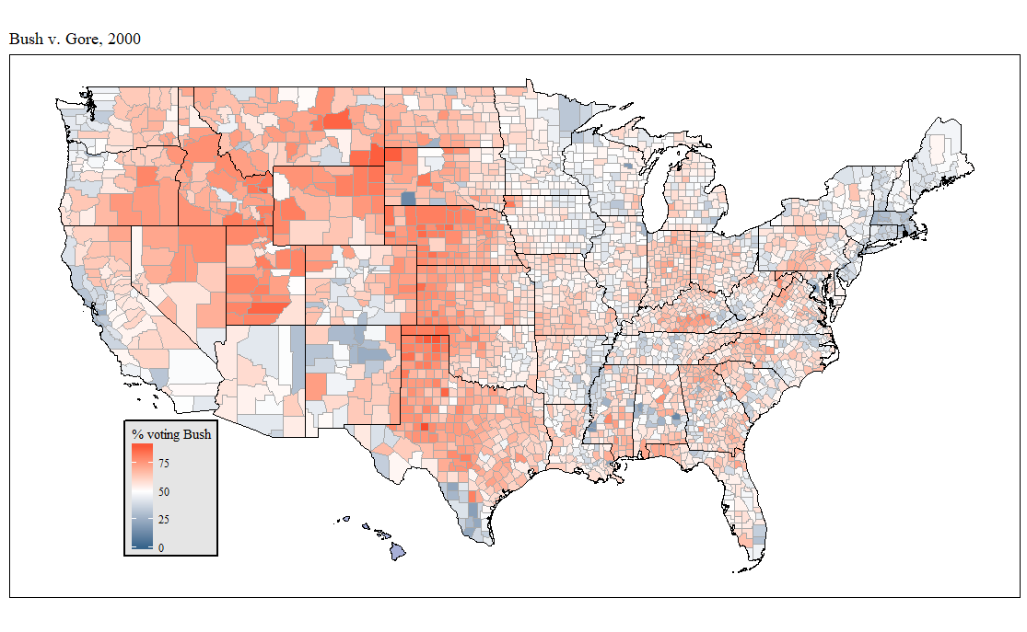

Slide 6
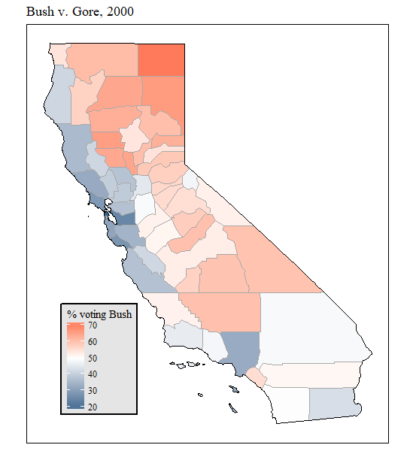
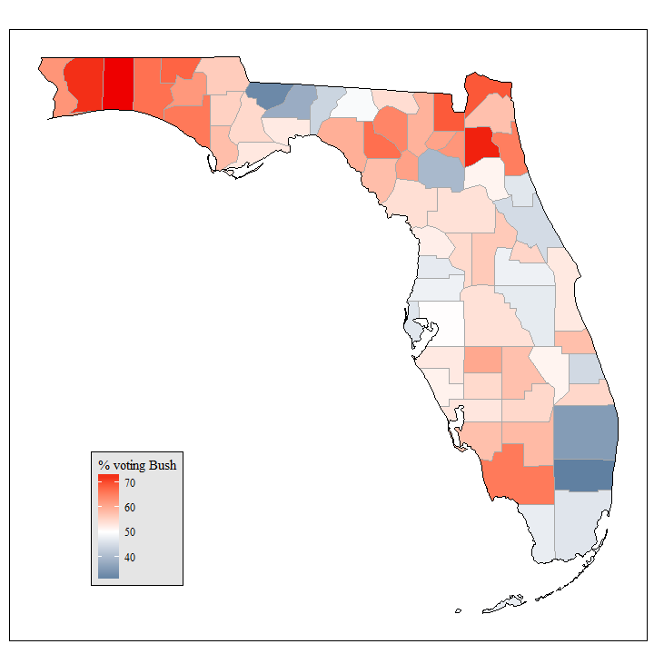

Slide 7
The data
After cleaning data, there are 3125 counties.

Slide 8
The data
After cleaning data, there are 3125 counties.
Used 38 total variables/predictors consisting of demographic data, housing data, labor data, public data (i.e. data about government activities) and features engineered from those.

Slide 9
The data
After cleaning data, there are 3125 counties.
Used 38 total variables/predictors consisting of demographic data, housing data, labor data, public data (i.e. data about government activities) and features engineered from those.
All data except latitude and longitude came from the U.S. Census Bureau's (unmaintained) Counties Database at http://www.census.gov/support/USACdataDownloads.html.

Slide 10
Variable | Description | Variable | Description
rpct | % (of voters in county) that voted for Bush in 2000
1 hs | % (of county) with HS diploma | 20 age35_54 | % aged 35-54
2 nohealthinsurance | % without health insurance | 21 age55_ov | % aged 55+
3 vehperhouse | avg. # vehicles per house | 22 vcperpop | # known violent crimes per population
4 poverty | % below poverty line | 23 homeaffordability | per capita income / median home value
5 bluecollaroccs | % farming, fishing, forestry, construction, maintenance, production, transportation, extraction occupations | 24 urban | % living in urban areas
6 flow10yr | % population change 1990-2000 | 25 farm | % living in rural farm areas
7 white1nh | % white only and non-Hispanic | 26 voterparticip | voter participation rate
8 asian1 | % Asian only | 27 houseperpop | # houses per population
9 other1 | % other race | 28 logincollege | log(% of county in college)
10 multirace | % multiracial | 29 logba | log(% of county with Bachelor's degree)
11 hispanic | % Hispanic of any race | 30 logpctmultiunitdwelling | log(% of houses w/2+ units)
12 lat | latitude of county centroid | 31 logmedianhvalue | log(median home value)
13 long | longitude of county centroid | 32 logmediangrossrent | log(median gross rent)
14 nevermarried | % never married | 33 logunemployed | log(% of civilian labor force unemployed)
15 married | % currently married | 34 logpci | log(per capita income)
16 sepdiv | % separated or divorced | 35 logforeignborn | log(% of county born outside US)
17 logpop | log(population in 2000) | 36 lognonenglish | log(% speaking non-English language at home)
18 logpoppersqmi | log(population density in 2000) | 37 loglandsqmi | log(land area in square miles)
19 age20_34 | % aged 20-34 | 38 loghomeless | log(% homeless in county)

Slide 11
Variable | Description | Variable | Description
rpct | % (of voters in county) that voted for Bush in 2000 | Which do you think will be | most predictive?
1 hs | % (of county) with HS diploma | 20 age35_54 | % aged 35-54
2 nohealthinsurance | % without health insurance | 21 age55_ov | % aged 55+
3 vehperhouse | avg. # vehicles per house | 22 vcperpop | # known violent crimes per population
4 poverty | % below poverty line | 23 homeaffordability | per capita income / median home value
5 bluecollaroccs | % farming, fishing, forestry, construction, maintenance, production, transportation, extraction occupations | 24 urban | % living in urban areas
6 flow10yr | % population change 1990-2000 | 25 farm | % living in rural farm areas
7 white1nh | % white only and non-Hispanic | 26 voterparticip | voter participation rate
8 asian1 | % Asian only | 27 houseperpop | # houses per population
9 other1 | % other race | 28 logincollege | log(% of county in college)
10 multirace | % multiracial | 29 logba | log(% of county with Bachelor's degree)
11 hispanic | % Hispanic of any race | 30 logpctmultiunitdwelling | log(% of houses w/2+ units)
12 lat | latitude of county centroid | 31 logmedianhvalue | log(median home value)
13 long | longitude of county centroid | 32 logmediangrossrent | log(median gross rent)
14 nevermarried | % never married | 33 logunemployed | log(% of civilian labor force unemployed)
15 married | % currently married | 34 logpci | log(per capita income)
16 sepdiv | % separated or divorced | 35 logforeignborn | log(% of county born outside US)
17 logpop | log(population in 2000) | 36 lognonenglish | log(% speaking non-English language at home)
18 logpoppersqmi | log(population density in 2000) | 37 loglandsqmi | log(land area in square miles)
19 age20_34 | % aged 20-34 | 38 loghomeless | log(% homeless in county)

Slide 12
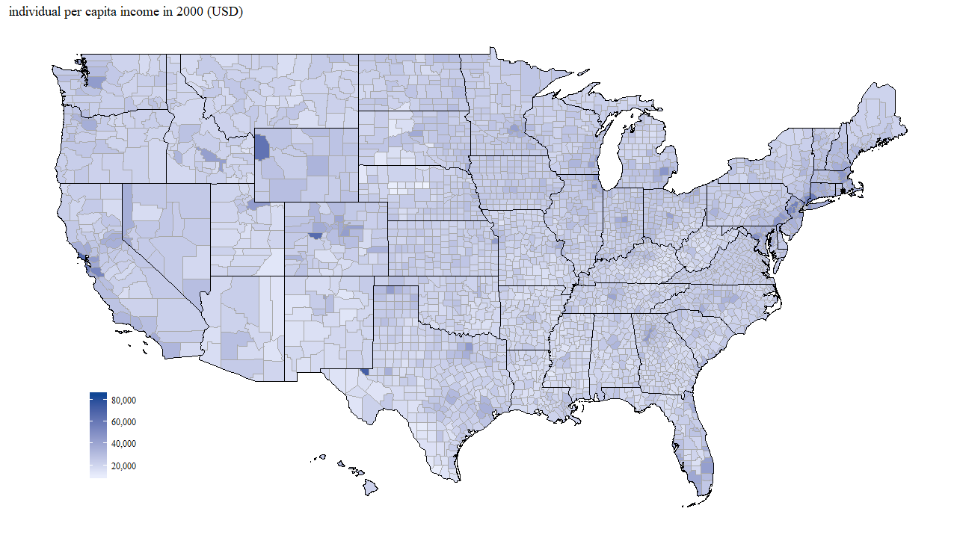

Slide 13
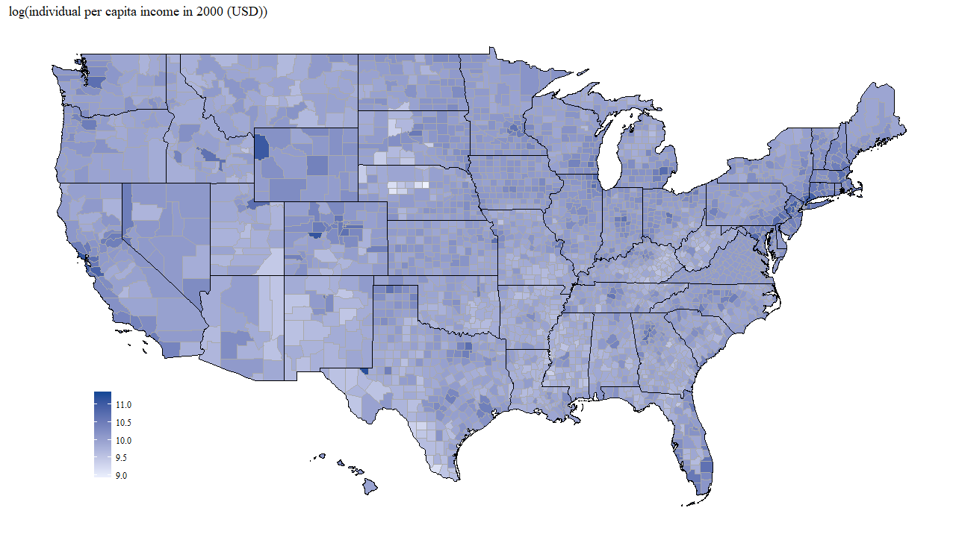

Slide 14
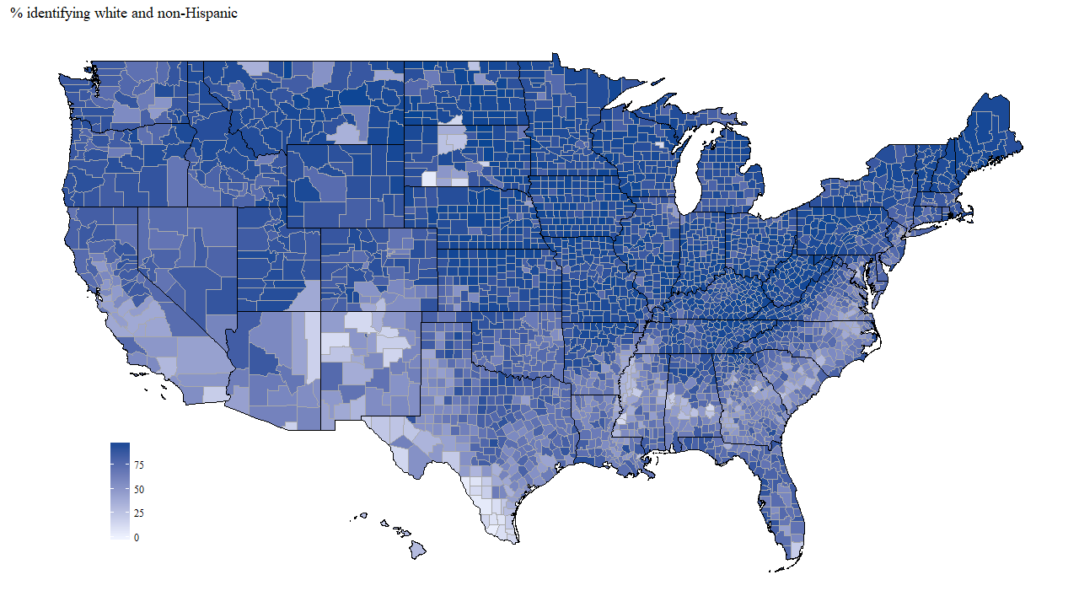

Slide 15
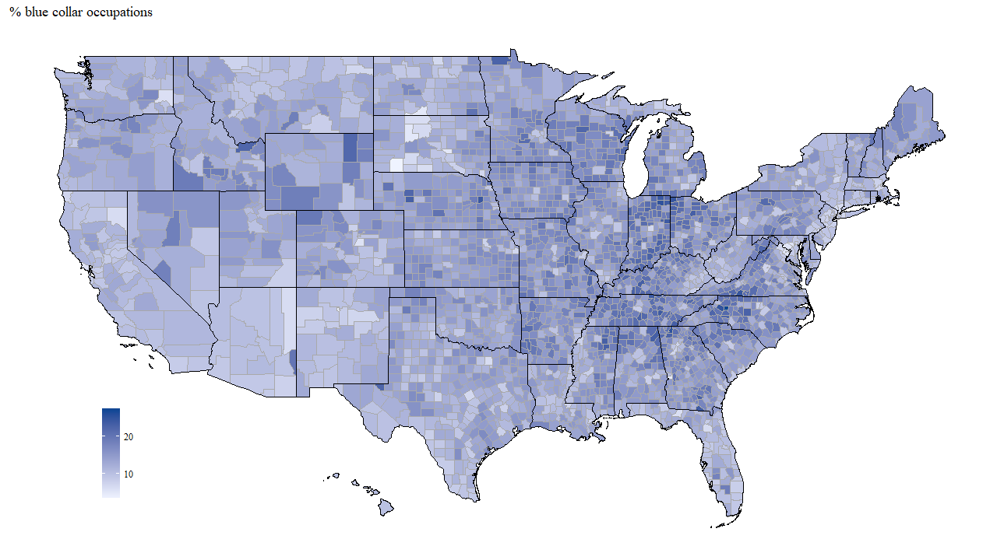

Slide 16
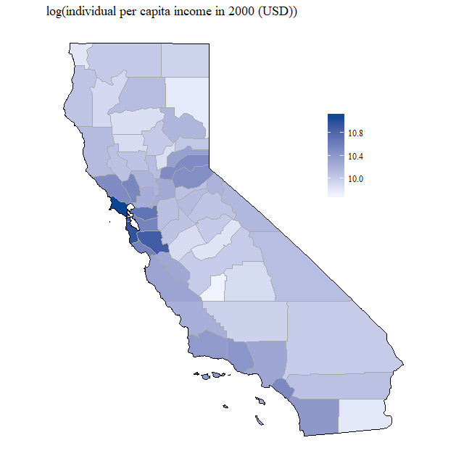
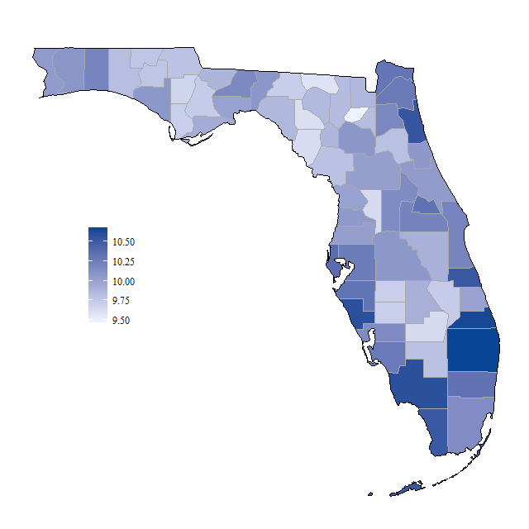

Slide 17
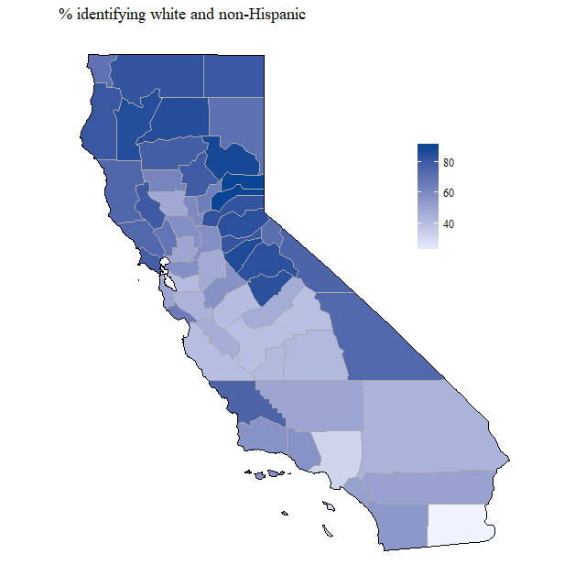
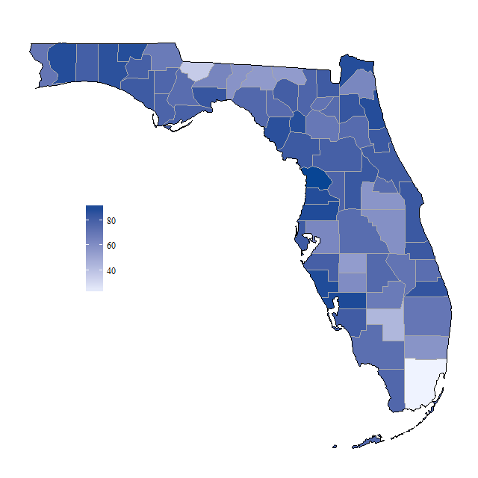

Slide 18
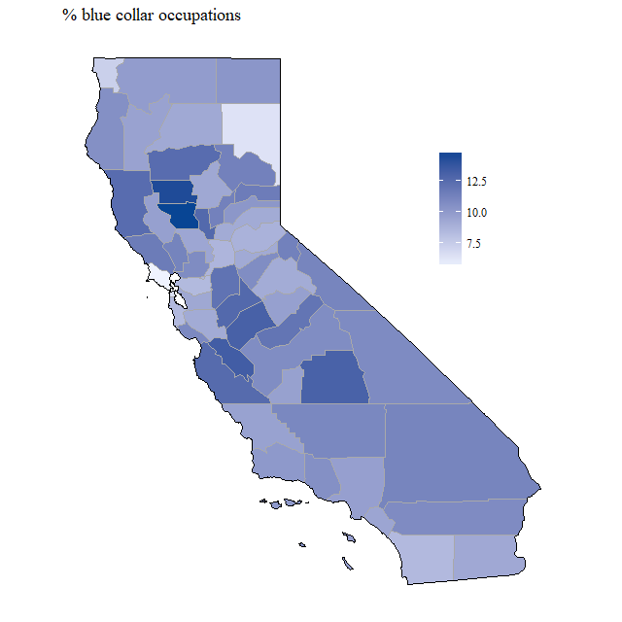
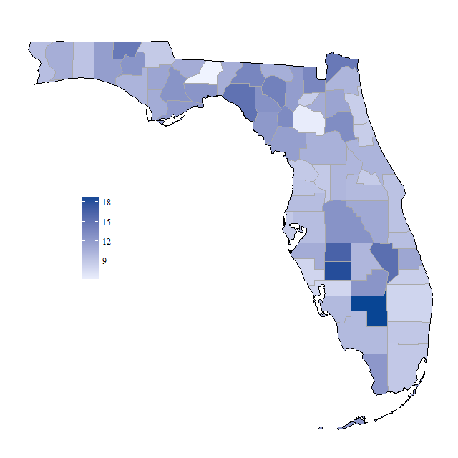

Slide 19
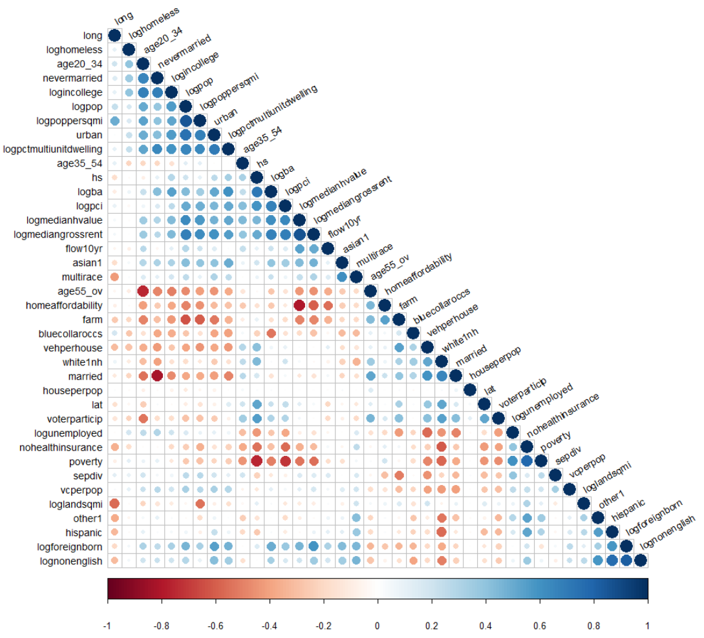
Correlation
plot

Slide 20
Predicting election results: Model selection
Chose algorithmically from several candidate models

Slide 21
Predicting election results: Model selection
Chose algorithmically from several candidate models.
Goodness of fit measure:
R² = correlation(rpct, prediction)²

Slide 22
Predicting election results: Model selection
10-fold cross validation

Slide 23
Predicting election results: Model selection
10-fold cross validation
Randomly divide set of all counties into 10 equally sized groups.

Slide 24
Predicting election results: Model selection
10-fold cross validation
Randomly divide set of all counties into 10 equally sized groups.
For each candidate model m,

Slide 25
Predicting election results: Model selection
10-fold cross validation
Randomly divide set of all counties into 10 equally sized groups.
For each candidate model m,
For each group of counties g,

Slide 26
Predicting election results: Model selection
10-fold cross validation
Randomly divide set of all counties into 10 equally sized groups.
For each candidate model m,
For each group of counties g,
i. “Train” an instance of m by observing relationships between census data and vote split in the other 9 groups, setting g aside.

Slide 27
Predicting election results: Model selection
10-fold cross validation
Randomly divide set of all counties into 10 equally sized groups.
For each candidate model m,
For each group of counties g,
i. “Train” an instance of m by observing relationships between census data and vote split in the other 9 groups, setting g aside.
ii. Use this trained instance of m to predict county vote for each county in group g.

Slide 28
Predicting election results: Model selection
10-fold cross validation
Randomly divide set of all counties into 10 equally sized groups.
For each candidate model m,
For each group of counties g,
i. “Train” an instance of m by observing relationships between census data and vote split in the other 9 groups, setting g aside.
ii. Use this trained instance of m to predict county vote for each county in group g.
iii. Record the goodness of fit of candidate model m on the counties in g.

Slide 29
Predicting election results: Model selection
10-fold cross validation
Randomly divide set of all counties into 10 equally sized groups.
For each candidate model m,
For each group of counties g,
i. “Train” an instance of m by observing relationships between census data and vote split in the other 9 groups, setting g aside.
ii. Use this trained instance of m to predict county vote for each county in group g.
iii. Record the goodness of fit of candidate model m on the counties in g.
b. Take the average goodness of fit of the candidate model m across all groups g.

Slide 30
Predicting election results: Model selection
10-fold cross validation
Randomly divide set of all counties into 10 equally sized groups.
For each candidate model m,
For each group of counties g,
i. “Train” an instance of m by observing relationships between census data and vote split in the other 9 groups, setting g aside.
ii. Use this trained instance of m to predict county vote for each county in group g.
iii. Record the goodness of fit of candidate model m on the counties in g.
Take the average goodness of fit of the candidate model m across all groups g.
Choose the best-performing candidate model.

Slide 31
Predicting election results: Model selection
Candidate model | Average goodness of fit
Generalized linear model | 0.6222
Support vector machine (linear kernel) | 0.6258
k-nearest neighbors | 0.6798
Decision tree (CART) | 0.3557
Random forest
Stochastic gradient boosting | 0.77

Slide 32
Most predictive variables
Metric \ Model | Generalized linear | Stochastic gradient boosting
Goodness of fit
Most predictive/ important variables, in descending order of importance (model-dependent)

Slide 33
Most predictive variables
Metric \ Model | Generalized linear | Stochastic gradient boosting
Goodness of fit | 0.631
Most predictive/ important variables, in descending order of importance (model-dependent) | white1nh vehperhouse lat nohealthinsurance married age55_ov logba logpoppersqmi

Slide 34
Most predictive variables
Metric \ Model | Generalized linear | Stochastic gradient boosting
Goodness of fit | 0.631 | 0.772
Most predictive/ important variables, in descending order of importance (model-dependent) | white1nh vehperhouse lat nohealthinsurance married age55_ov logba logpoppersqmi | nevermarried long white1nh vehperhouse lat logpoppersqmi married sepdiv

Slide 35
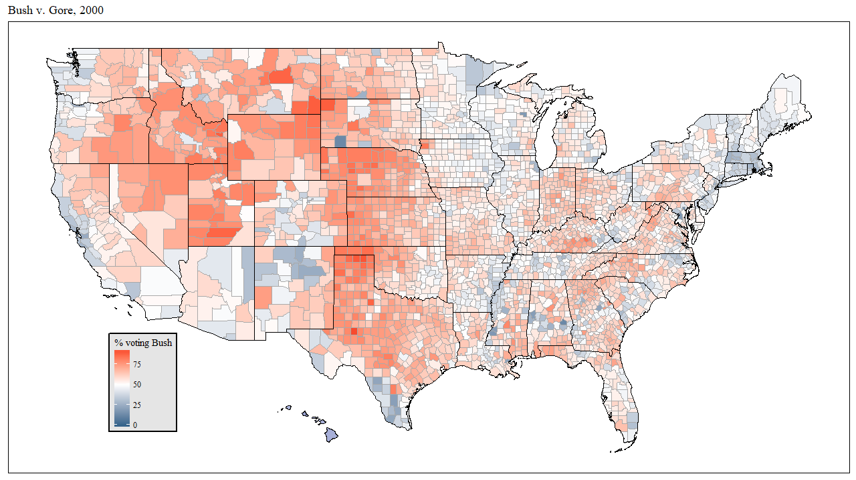
Actual vote, 2000

Slide 36
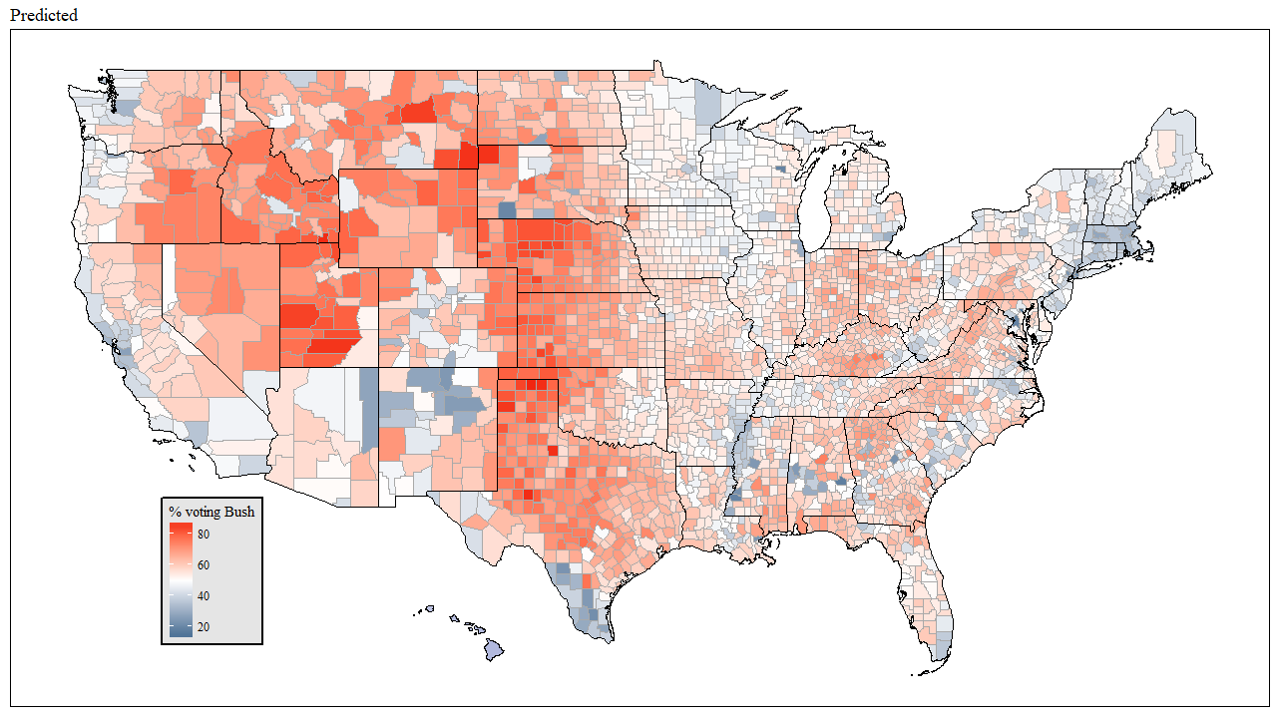
Predicted vote, 2000
R² = 0.772

Slide 37
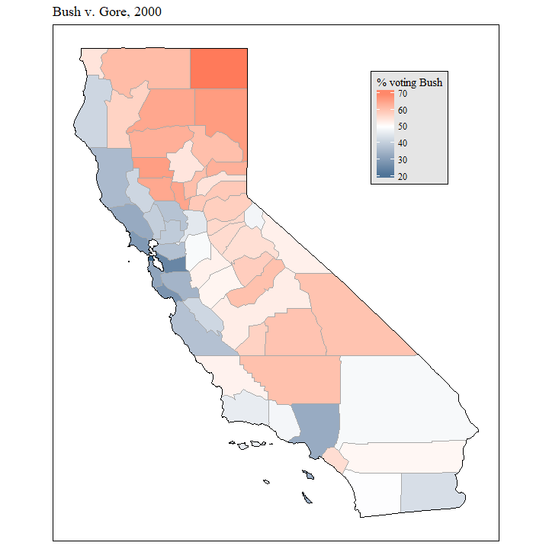
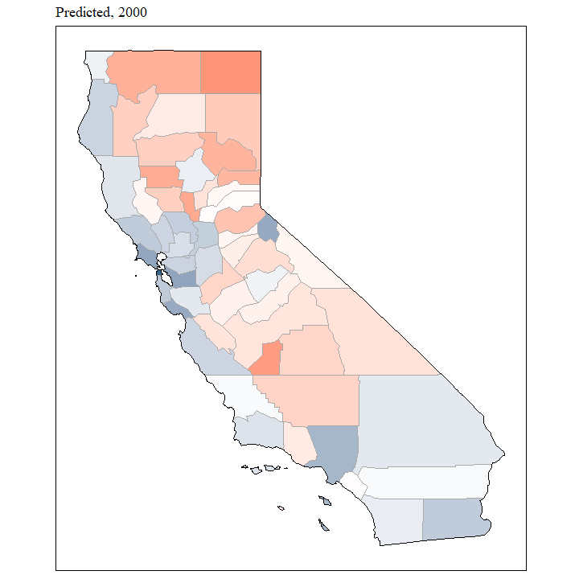
Actual vote, 2000
Vote predicted from non-California county patterns, 2000
R² = 0.707

Slide 38
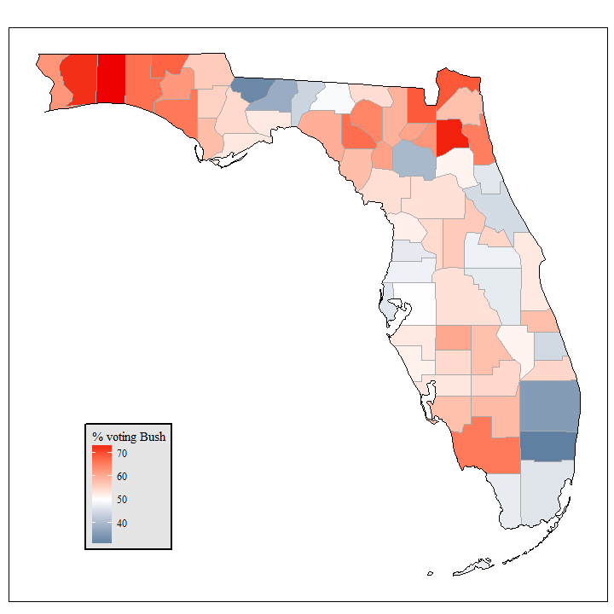
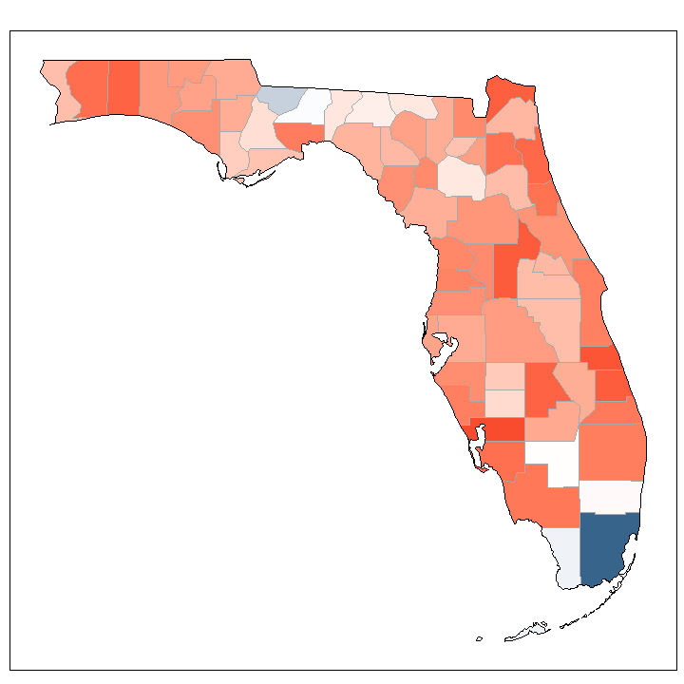
Actual vote, 2000
Vote predicted from non-Florida county patterns, 2000

Slide 39
Actual vote, 2000
Vote predicted from non-Florida county patterns, 2000
R² = 0.196

Slide 40
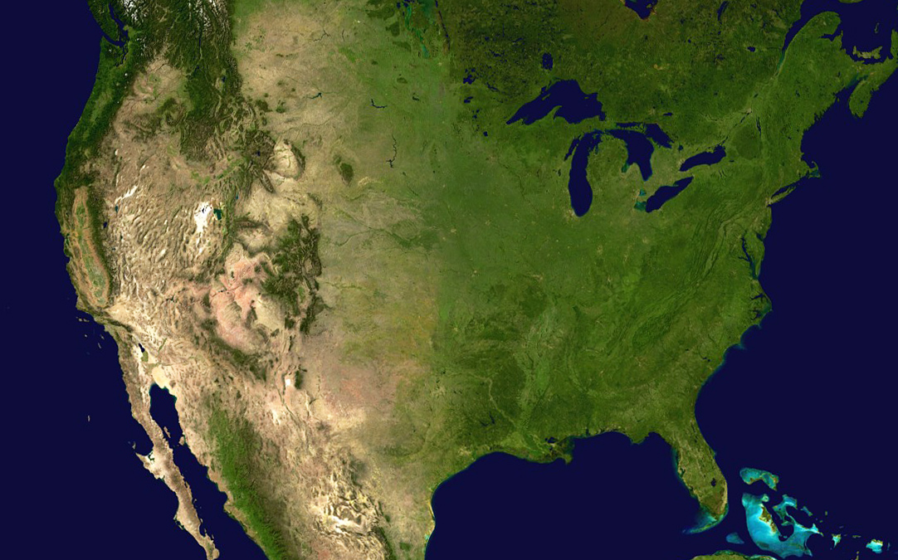
Thank you for listening!

